Slide 1
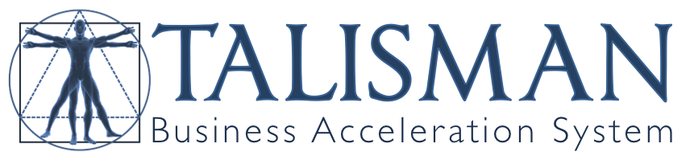

Slide 2
Structure Of TALISMAN
    Divided into 5 Sections
    23 Modules
    Workbooks
    Resources and Strategies

Slide 3
SECTION 1: PREPARATION
1. Getting Ready For Success
Preparation For Success...
Making The Business Marketable:
Niche market(s)
Creating your own USP (unique selling proposition)
Other benefits of your product or service
Risk reversal and guarantees – eliminating the risk
Creating testimonials that get results
Creating irresistible offers
Lead generation strategy to maximise your return on investment
Setting your objectives to give you direction
‘Budgeting’ for your lead generation marketing tools
SECTION 1: PREPARATION
MODULE 1

Slide 4
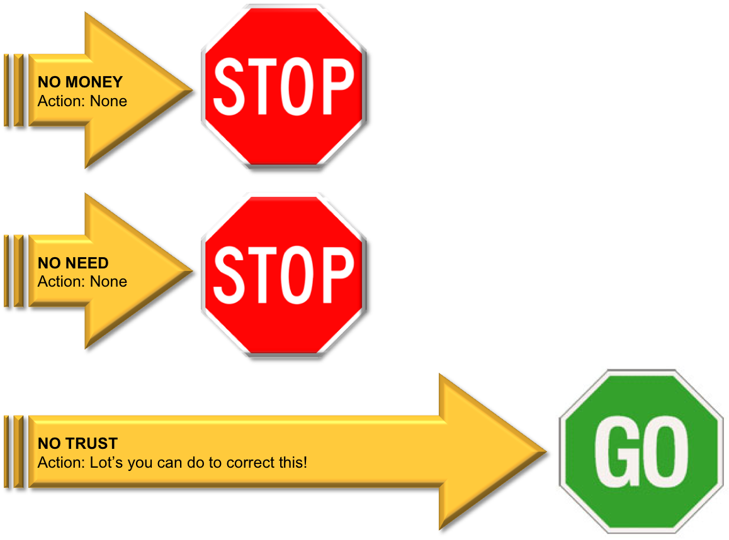
1. Getting Ready For Success
Understanding The Three Reason Why People Don’t Buy:
There is not much you can do about the first two: Money and Need…
But there are many things that can do about the third - Trust…
SECTION 1: PREPARATION
MODULE 1
You have to develop the level of trust and believability that they need in you to do business with you!

Slide 5
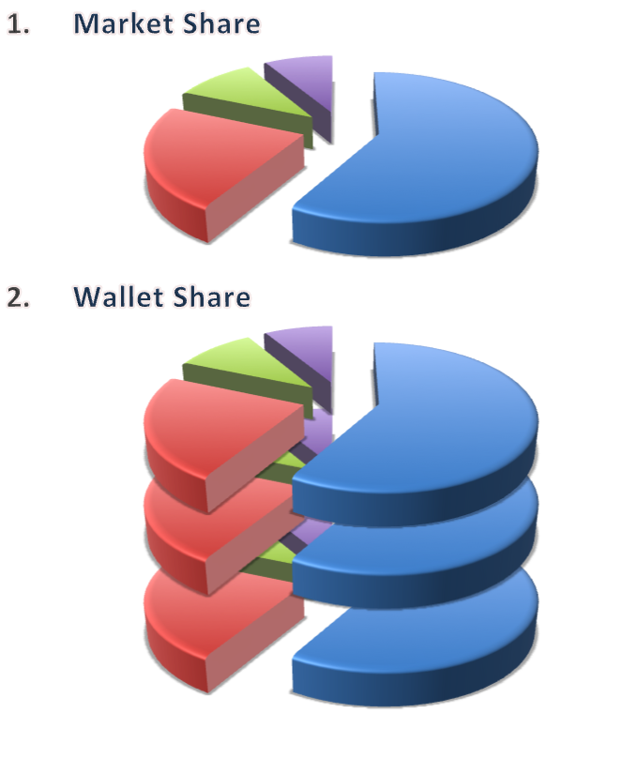
1. Getting Ready For Success
Market Share vs Wallet Share
Finding new customers is 7 – 8 times more difficult!
SECTION 1: PREPARATION
MODULE 1
It is far easier to do business with people that already know you.
Getting more Wallet Share is the most effective way to maximise profits!

Slide 6
2. Niche Marketing
“You Can’t Be All Things To All Men”
Stop marketing to the wrong people
Define your market and target it
Concentrate on well chosen segments or niches
SECTION 1: PREPARATION
MODULE 2
A niche market is a specific group of people or businesses that want and need your product or service, and can afford to pay for it!
Find niches that others are only paying little or no attention to.
By marketing to a specific niche you are stating that you are the company that knows their needs and requirements best.
If no one else meets their needs in this way then you are seen as the logical company to turn to.

Slide 7
2. Niche Marketing
Example: You need an accountant for your new start up business. You check Google and Yellow Pages in your Area. Although there are several entries the first two ads read:
Ad 1
‘ABC Chartered Accountants. Tax preparation, auditing, bookkeeping, payroll services, help for start-ups, management accounts, and so on.’
SECTION 1: PREPARATION
MODULE 2
Ad 2
XYZ Chartered Accountants. Specialising in helping Start-Ups get their businesses running quickly, profitably and effectively.’
Who Would You Choose?

Slide 8
2. Niche Marketing
How To Find And Choose A Niche
  The 5 Stages:
  Stage 1: Competitive Analysis
  Stage 2: Your Own Company Analysis
  Stage 3: Identifying Possible Niche(s)
  Stage 4: Choosing Your Perfect Niche(s)
  Stage 5: Define Your Chosen Niche(s)
ACTION
POINTS
SECTION 1: PREPARATION
MODULE 2

Slide 9
3. Unique Selling Proposition
The USP is the one real benefit that differentiates you from your competition in the mind of your prospect.
“What’s the one unique thing you offer that makes your prospects think ‘Wow, I must have this product or service’?”
SECTION 1: PREPARATION
MODULE 3
Why do people do business with you?
If people aren’t doing business with you, why should they?
If your prospect can immediately see what it is you do that is so unique and they find it irresistible – you’ve created the perfect USP.
Your USP is what makes the difference between having a truly outstanding business or a faltering one.

Slide 10
3. Unique Selling Proposition
Some well known USP’s:
“Red hot pizza delivered to your door in 30 minutes or less guaranteed.” Dominoes Pizza
"We're Number Two. We Try Harder." Avis
SECTION 1: PREPARATION
MODULE 3
“When it absolutely positively has to be there overnight.” FedEx.
"To our members, we're the fourth emergency service” AA
A good USP:
Attracts attention.
Distinguish you from the competition.
Motivate your prospects to take action NOW.
Fulfill an industry gap.

Slide 11
3. Unique Selling Proposition
How To Create A USP:
ACTION
POINTS
STEP 1. Understand that you’re not selling a product or service, you’re selling a major solution to your niche’s most pressing problem(s).
List the problems faced by your specific niche(s) and explain HOW you solve them
STEP 2. In an ideal world what would your chosen niche(s) want from your type of product or service?
STEP 3. Defining your USP - The two simple elements of USP.
STEP 4. Refining your USP
STEP 5. Testing
STEP 6. Refine (if necessary)
STEP 7. Using your USP
SECTION 1: PREPARATION
MODULE 3

Slide 12
4. Transferring the Features Of Your Product Or Service Into Sizzling Benefits
People don’t in reality buy your product or service and what you do for them (features), they buy the results your product or service brings them (benefits).
SECTION 1: PREPARATION
MODULE 4
“Sell the sizzle and not the steak”
A FEATURE is a physical aspect of the product – A ‘thing’ (logical approach).
A BENEFIT is what someone gets from the product – ‘What’s in it for me’ (emotional approach).
Companies and salespeople often confuse the two and sell FEATURES

Slide 13
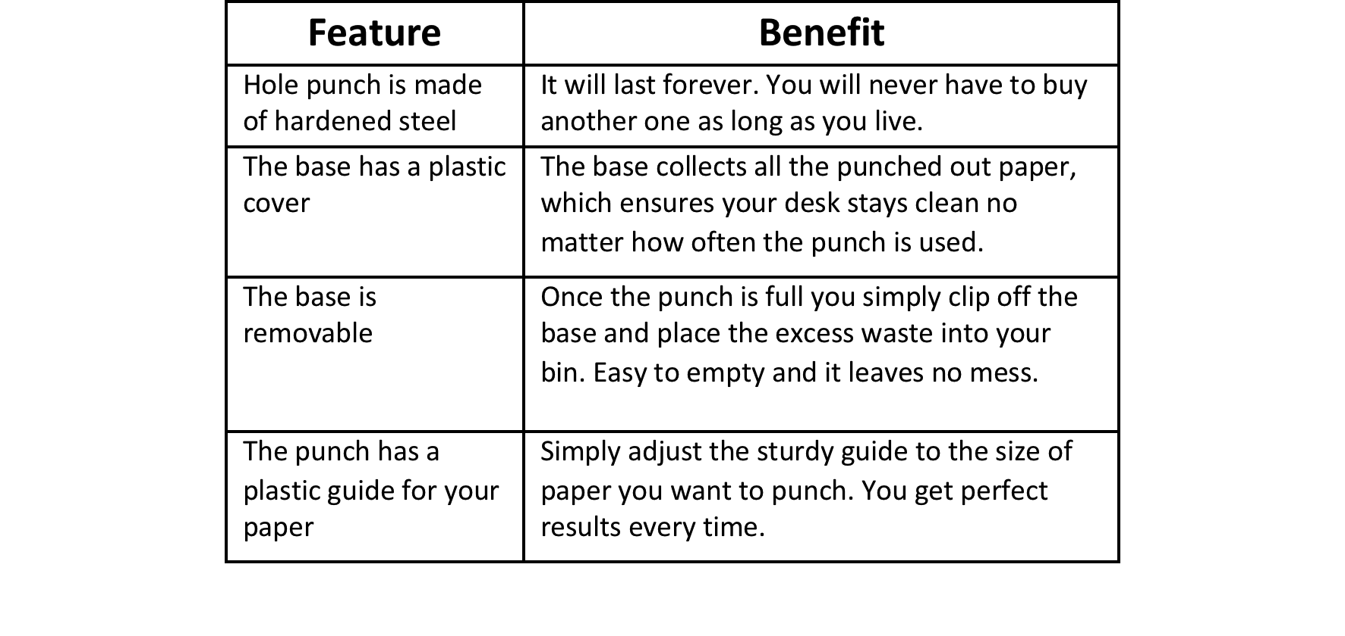
4. Transferring the Features Of Your Product Or Service Into Sizzling Benefits
ACTION
POINTS
How To Convert Features Into Benefits:
STAGE 1: What benefits are your competitors offering?
STAGE 2: Build your list of benefits to completely surpass any of your competitors using our principle of ‘Benefit Pile-Up.’
This alone will make you irresistible to your potential clients or customers!
SECTION 1: PREPARATION
MODULE 4

Slide 14
5. Risk Reversal
Any time a sale is made, one of the parties assumes more of the risk than the other…
Who takes most of the risk - the buyer or the seller?
The prevailing thinking…
“If I offer a money-back guarantee people will take advantage of me and I’ll lose money.”
SECTION 1: PREPARATION
MODULE 5
The proven facts…
  You MAY get more returns
  You will make customers happy
  You will make many more sales
  The additional sales will more than offset any returns you get

Slide 15
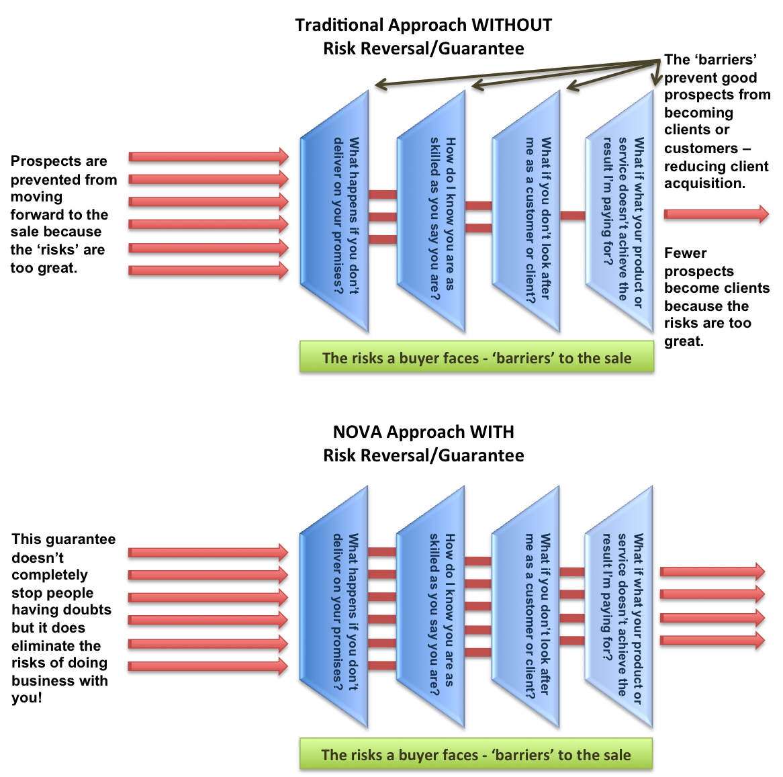
5. Risk Reversal
If you lower or eliminate the risk, then the natural consequence is people will be more inclined to buy from you.
SECTION 1: PREPARATION
MODULE 5

Slide 16
5. Risk Reversal
As soon as you add a guarantee to your business you…
Remove the risks gaining more clients or customers
Automatically differentiate your business from your competition
And, your prospects will value your business much more, because they’ll automatically assume you must good at what you do.
The result is a HUGE increase in sales and an avalanche of clients or customers!
SECTION 1: PREPARATION
MODULE 5
Risk Reversal is essentially a ‘sales conversion strategy’
Most businesses and business people stand behind what they do. This is the key to risk reversal.
People only benefit from a product or service once they’ve bought it. This risk is what prevents them buying.
So, it makes sense to remove the risk!

Slide 17
5. Risk Reversal
Because you offer risk reversal, your prospect can’t help but think and assume the following about you…
If you’re offering this risk reversal guarantee, you must be very good at what you do
You must be ‘stupid’ to offer such a guarantee if you were poor at delivering your promises
In the prospect’s mind your risk reversal has ‘proven’ to him or her that you can give them exactly what they need.
More importantly, when most people choose to buy a product or service, they choose it for perfectly good reasons and intentions. And they spend time making their decision.
They wouldn’t choose you in the first place if they wanted to capitalise on your risk reversal.
SECTION 1: PREPARATION
MODULE 5
Risk reversal is so powerful that once defined can become or be incorporated into the USP.

Slide 18
5. Risk Reversal
Constructing A Risk Reversal Strategy…
  Ask the following questions:
  Do I get many complaints about my product(s) or service(s) from my clients or customers?
  What is the end result my clients or customers are getting from receiving my product(s) or service(s)?
  Do my competitors offer any guarantees? If they do, what are they?
  What are the three main things that can prevent my clients or customers from buying from me?
  What are the main three irritations/frustrations clients have about my industry in general? How can I overcome these?
  What is the pain or fear your clients or customers have?
  What pain or loss can you inflict on yourself or business if you don’t follow through with your promises?
ACTION
POINTS
SECTION 1: PREPARATION
MODULE 5
When you put together your risk reversal try and eliminate any conditions. The more conditions you have – the less attractive your risk reversal will be.

Slide 19
6. Testimonials
One of the most powerful sales and marketing tools, but also the most under-utilised.
If they don’t believe you – then you don’t get the lead. If you don’t get the lead you don’t get the sale. It’s as simple as that!
SECTION 1: PREPARATION
MODULE 6
A testimonial is simply a statement of praise from a satisfied client or customer (or sometimes a celebrity).
Testimonials add credibility, believability and proof!
It isn’t just you saying it anymore. Buyers can relate to testimonial:
“If it worked for them then it can work for me too!”

Slide 20
6. Testimonials
What Makes A Testimonial Powerful?
  Identify Persons Giving Testimonials By Their Name, Their Title, What They Do, And Where They’re From.
  Make Sure Your Testimonials Are Specific.
  Is The Testimonial Positive?
  Is The Testimonial Clear?
  The Amazing Secret Nobody Uses.
  Get Testimonials From Both Sexes.
  A Testimonial Should Always Be Enclosed By Quotation Marks.
  A Testimonial Is Stronger When It Is Accompanied By The Photo Of The Person Giving The Testimonial.
  Testimonials Don’t Have To Come Solely From Clients Or Customers.
  Each Testimonial Should Vary From The Next To Enable You To Match Testimonials To The Prospects Circumstances.
  Try To Get Your Testimonials On Different Formats.
SECTION 1: PREPARATION
MODULE 6

Slide 21
6. Testimonials
How To Get Testimonials
  Getting testimonials is simple:
  Ask For A Testimonial Straight After Completing Some Work For The Client.
  Writing The Testimonial Yourself With A Helping Hand From Your Client Or Customer.
  Unsolicited testimonial letters.
  Contests.
  Feedback Sheets and Questionnaires.
  Well Known People.
  Conversational Comments.
  Seminars.
  Appreciation.
ACTION
POINTS
SECTION 1: PREPARATION
MODULE 6
“Use testimonials in every marketing communication you have with your prospects and you’ll get more leads, more sales and more clients or customers - guaranteed!”

Slide 22
7. Irresistible Offers
How To Multiply Sales And Profits
Understanding ‘Cost Of Client Acquisition’
The ‘cost of client acquisition’ is the amount of money you are prepared to spend on lead generation to get a new client or customer.
This can be high – Nothing necessarily wrong with this.
Understanding ‘Lifetime Customer Value’
The ‘lifetime customer value’ is the average profit a client or customer generates for you during the lifetime of the relationship.
SECTION 1: PREPARATION
MODULE 7
Knowing these gives a business enormous advantage. It now knows that it can spend MORE to acquire a new customer.
The business goes from:
‘How much money did we make on the first order?’
To:
‘How much money have we made over the duration of the relationship?’

Slide 23
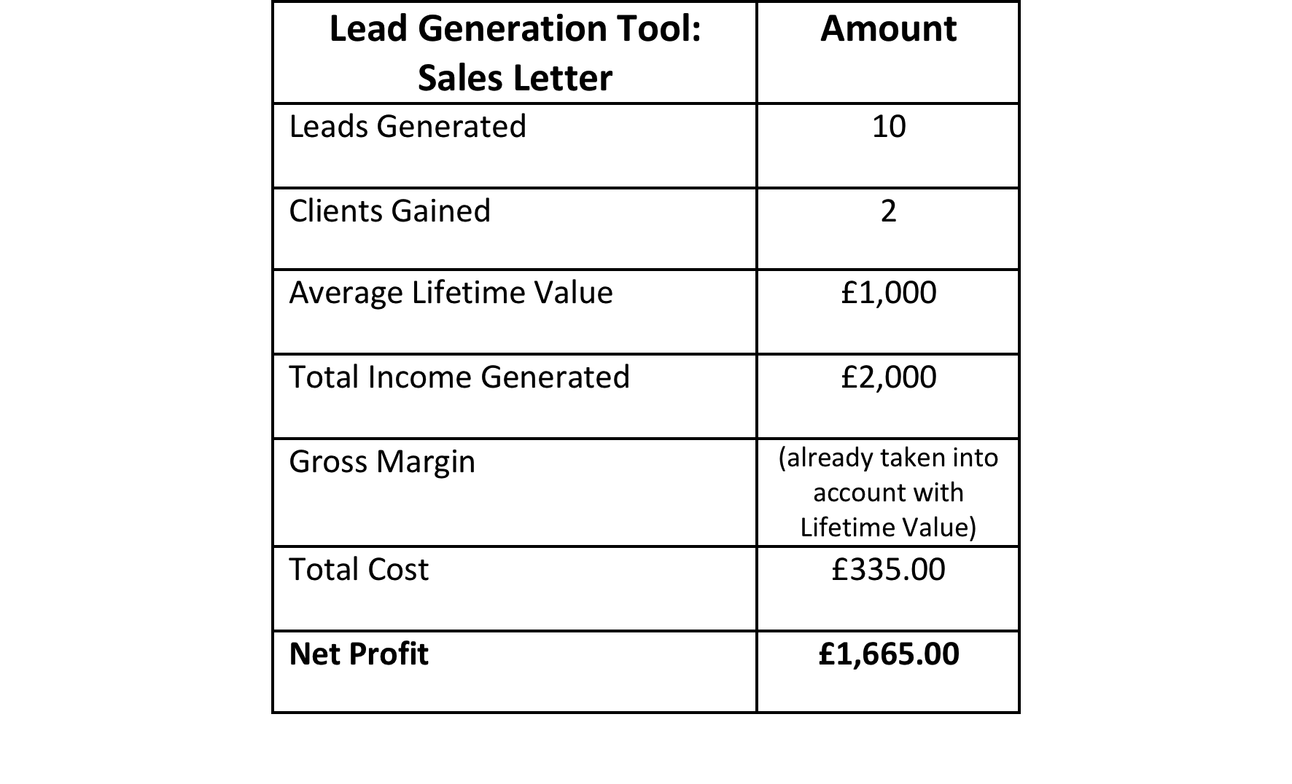
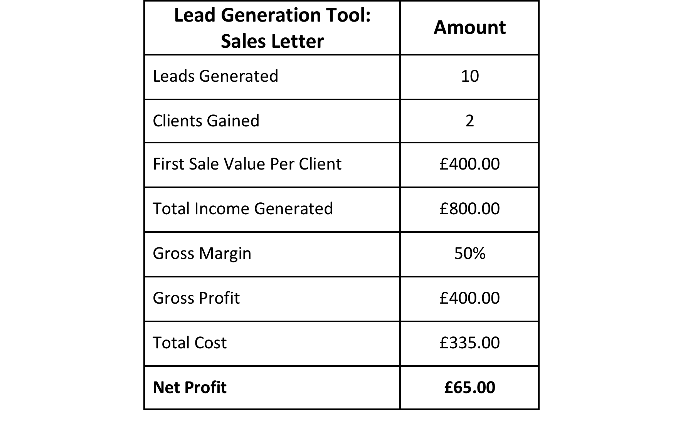
7. Irresistible Offers
Traditional Approach
SECTION 1: PREPARATION
MODULE 7
Acquisition Approach

Slide 24
7. Irresistible Offers
How To Create An Irresistible Offer
ACTION
POINTS
Born from combining the dual power of ‘cost of client acquisition’ and ‘lifetime customer value.’
Using Irresistible Offers is like ‘bribing’ prospects to become your customers. You are not focussing on the first sale but on the amount of profit over the duration of the relationship.
SECTION 1: PREPARATION
MODULE 7
Three Ways That Work:
  Free trials of the product or service.
  Free Special Reports.
  Free additional products or services.
Think: ‘What can I offer my prospects that they simply can't refuse?’
Don’t Discount! It significantly reduces profit and cheapens the product or service

Slide 25
8. Your Lead Generation Strategy
Maximising Response By Matching Lead Generation To Niche Markets
Most businesses market themselves in the same way and use the same distribution or sales channels.
SECTION 1: PREPARATION
MODULE 8
Very few business people give any great thought to the types of lead generation tools they should be using. They adopt the same marketing tools as all their competitors are using.
This means two things:
  In most cases the best lead generation tools to attract the target market or niche is NOT being used.
  Lead generation campaigns are wasteful – even if they are still profitable.

Slide 26
8. Your Lead Generation Strategy
How To Choose The Right Lead Generation Tools:
ACTION
POINTS
This is quite simple and the preparatory ‘work’ should have already been done in the earlier modules.
Two Questions:
  Can your message be given to your niche easily?
  What publications/media do they read? How might we get their attention using search engines?
SECTION 1: PREPARATION
MODULE 8
Ask this…
“How do your niche typically source your type of product/service?”
EG: If you’re a plumber your niche is likely to source a plumber using Google (or another search engine) or Yellow Pages.
This is how your lead generation tools can start selecting themselves using this simple approach!
Coupling this with the types of publications they read, can give you ALL the information you need to choose the ‘perfect’ lead generation tools for your business.

Slide 27
8. Your Lead Generation Strategy
Laser Beam Focus:
Remain focused on each step and element of the sales process.
  For example…
  Let’s say you use a website to attract prospects. The main objective is to generate qualified leads. You’re using a Special Report as the ‘’Irresistible Offer.’
  That’s easy enough to understand. But here’s where most people go wrong…
  Remember the main objective is to get qualified leads using the Special Report. That means you need to completely focus on the Special Report and explain why your prospects should respond. That’s all that matters.
SECTION 1: PREPARATION
MODULE 8
Stay focused. Don’t try to achieve to many things at once. Do it step-by-step otherwise response can be significantly reduced.

Slide 28
9. Setting Objectives To Give You Direction
How To Drive The Business Forward:
  What do you want to achieve in the next 12 months?
  How will the business look in 3 or 5 years?
  Set goals and objectives.
  Write them down.
  Refer back and review periodically.
ACTION
POINTS
SECTION 1: PREPARATION
MODULE 9
Set your sights high rather than ‘achievable’ or low.
The first objective need to be to follow the TALISMAN plan step-by-step, page by page.

Slide 29
10. Budgeting
Why Budgeting Is Pointless
ACTION
POINTS
Most businesses know to the penny how much they spend on their marketing but have only vague notions of the returns that they get.
How To Set An ‘Interim Lead Generation Budget’
  What can you comfortably afford?
  Don’t over commit even though most Alchemy strategies are either low cost of no cost.
  Calculate Cost of Client Acquisition and Lifetime Customer Value.
  From these calculate the Interim Budget.
  Use this on each Lead Generation Tool to realistically evaluate which tools are the best to use.
  Once you start collecting results you can assess the good from the bad.
  And since you know which tools are profitable you won’t have to set a budget in the future.
SECTION 1: PREPARATION
MODULE 10
Remember: If it makes money, keep doing it! In fact, do it more!

Slide 30
SECTION 2: IMPLEMENTATION
11. Selecting Your Lead Generation Tools
ACTION
POINTS
How To Choose The Perfect Tools:
  Re-Read Module 8 – ‘HOW To Choose The Best Lead Generation Tools For Your Business’.
  Go to Volume 3.
  Prioritise Your Lead Generation Tools.
  Person Responsibility.
  Timing.
  Creating Each Lead Generation Tool.
  Activate Your Lead Generation System
SECTION 2: IMPLEMENTATION
MODULE 11

Slide 31
12. How To Multiply The Results Of Your Lead Generation Super System
Testing And Measuring For The Best Results…
Advertising legend John Caples said…
“I have seen one advertisement sell 19 times as much goods as another.”
This was achieved through testing!
SECTION 2: IMPLEMENTATION
MODULE 12
One question must be asked of all leads and and enquiries:
“Where did you hear about us?”
Use a contact management system to monitor the progress of a lead.
This way the Lead Generation Tool becomes MEASURABLE.

Slide 32
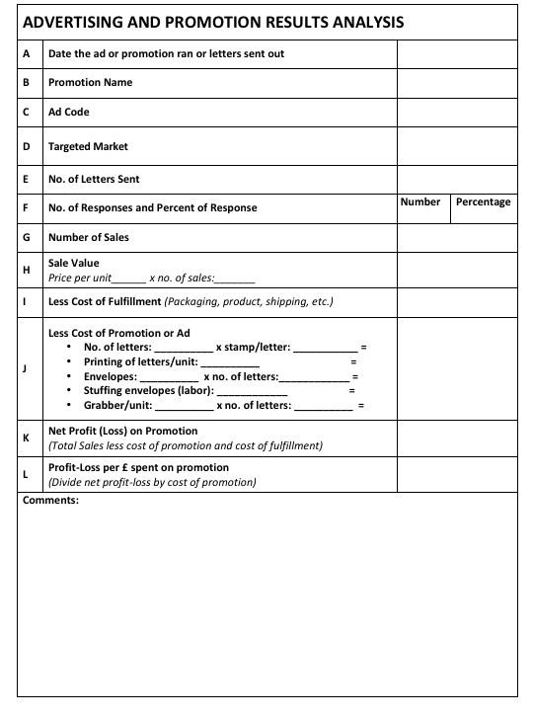
12. How To Multiply The Results Of Your Lead Generation Super System
ACTION
POINTS
How To Test:
  Test the components of the offer.
  Only test one component at a time.
  Record all results – Good and bad.
  Keep testing.
SECTION 2: IMPLEMENTATION
MODULE 12

Slide 33
SECTION 3: GETTING RESULTS
13. Sales Conversion
Turning More Prospects Into Buyers:
There is no point to having a brilliant lead generation system if you only convert a small percentage.
Concentrating more on ‘converting’ your leads into clients will ensure two things:
  You’ll literally transform your business overnight.
  You’ll maximise the investment you make on ALL your marketing.
SECTION 3: GETTING RESULTS
MODULE 13
On average it takes 7 positive contacts (‘The Rule of 7’) before your prospect says, “Yes”. These steps are automatically built into TALISMAN.

Slide 34
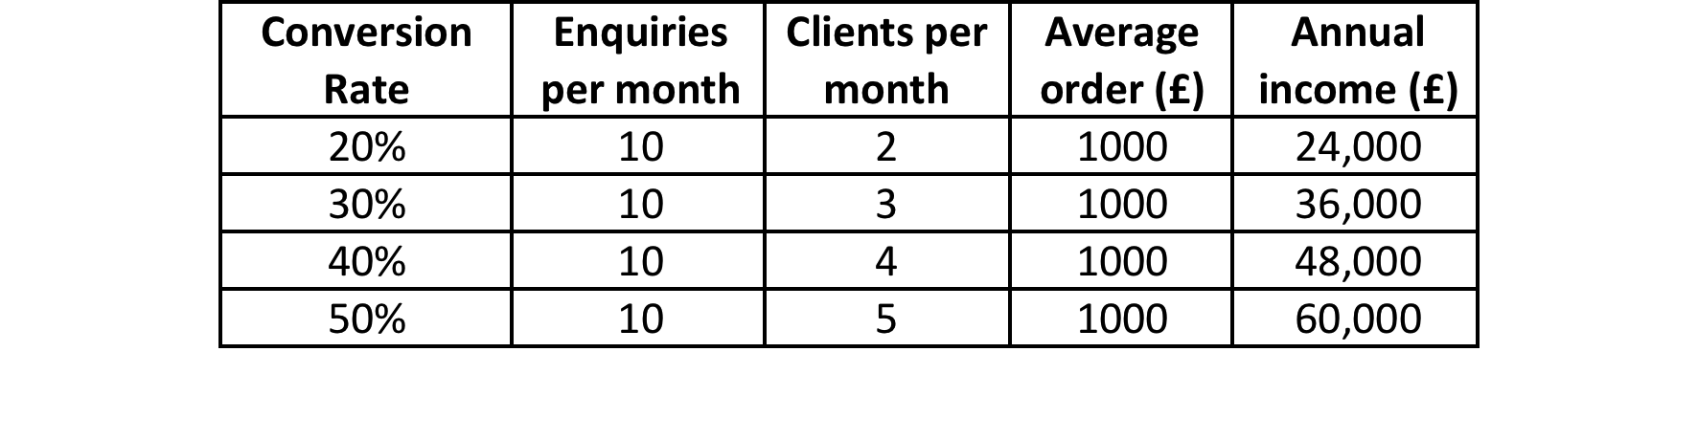
13. Sales Conversion
The effect of a sales conversion system on a business:
SECTION 3: GETTING RESULTS
MODULE 13
Improving your sales conversion rate from 20% - 30% results in a growth of 50%. Doubling your sales conversion rate from 20% - 40% results in a 100% growth in new business. That’s why your sales conversion process is so powerful and so important.
Improving your sales conversion rate is achieved without any extra cost.
Calculating Sales Conversion:
Conversion = Total No. of Clients Generated from Enquiries x 100
Rate (%) Total No. of Enquiries

Slide 35
13. Sales Conversion
The Parts To The Sales Conversion System:
ACTION
POINTS
Pricing Your Product or Service
Case Studies
Qualification Questions/Telephone Conversion Device
Sowing the Seeds Letter
Further Information Letter
Future Contact Letter
The Alchemy TALISMAN Sales System
Sales Conversion Letter
Follow Up Sales Conversion Letters
Buyers Remorse Letter
SECTION 3: GETTING RESULTS
MODULE 13

Slide 36
14. Pricing Your Product Or Service
Grow The Business Overnight By Setting The Perfect Price…
Price your products or services too high and you won’t get the business; price them too low and you’ll wish you hadn’t got the business; set your prices without testing and you could be losing thousands each and every week!
SECTION 3: GETTING RESULTS
MODULE 14
There are only two factors to consider when setting your price – value and profit.
Three things to understand:
  People on the whole buy on value and NOT on price!
  As a rule, people automatically value your product or service more if you charge higher.
  You can never determine your prices/fees you must let your prospects and clients or customers make that decision for you

Slide 37
14. Pricing Your Product Or Service
What To Charge…
  Determine the lowest price – This is the MINIMUM starting point.
  Then look at how high you can charge.
This figure is the minimum price you can charge and still have a successful business.
You can now decide whether or not you want to raise this figure by increasing your profit margins (easy) or increasing your activity rate (not as easy).
Optimal Pricing… shows what happens when pricing too low against pricing too high.
SECTION 3: GETTING RESULTS
MODULE 14

Slide 38
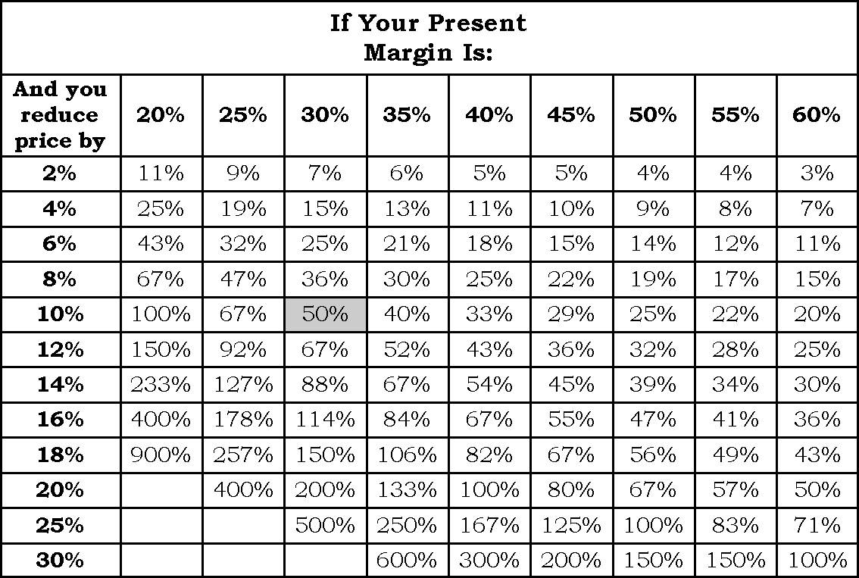
14. Pricing Your Product Or Service
Reducing Prices:
Discounting is the lazy man’s competitive strategy and is applicable in only one situation and that is where you have a definite cost advantage (either fixed or variable) over your competitors, and your product or service is one where customers are very price sensitive.
SECTION 3: GETTING RESULTS
MODULE 14
If your gross margin is 30% and you reduce price by 10%, you need volume to increase by 50% to maintain your initial profit! Rarely has this worked in the past and it's unlikely to work in the future.

Slide 39
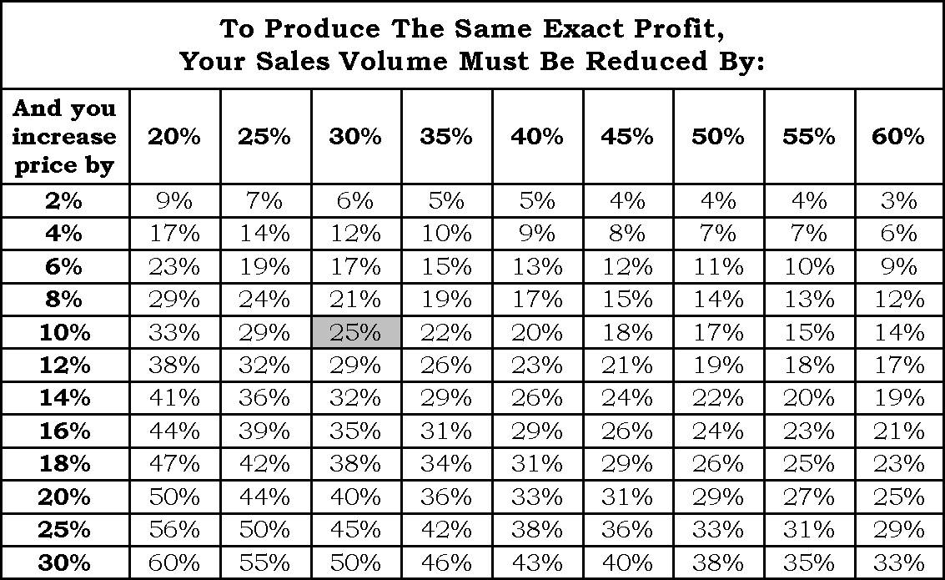
14. Pricing Your Product Or Service
Increasing Prices:
This shows the amount by which your sales would have to decline following your decision to increase your prices your gross profit is reduced below its initial level.
SECTION 3: GETTING RESULTS
MODULE 14
At a 30% margin and a 10% increase in price, you could sustain a 25% reduction in sales volume before your profit is reduced to the initial level………you would have to lose 1 out of every 4 customers!

Slide 40
14. Pricing Your Product Or Service
How To Set The Perfect Price:
ACTION
POINTS
  Decide on two additional price points.
  Test.
  Go with the price that works best.
  Keep testing.
SECTION 3: GETTING RESULTS
MODULE 14

Slide 41
15. Case Studies – Adding Proof, Credibility And Believability To Your Sales Message
A Simple Cost Effective Way To Prove You Can Do What You Say.
Case studies are very powerful in getting prospects to say, “Yes! I believe you can solve my problems.”
SECTION 3: GETTING RESULTS
MODULE 15
Here’s what case studies can do for you…
  Help convince the prospect you can achieve everything you say you can.
  Demonstrate you have the expertise.
  Offer “live” proof.
  They give you increased credibility in your market place.
  They “sell” your solutions to the prospect in a very subtle but powerful way.

Slide 42
15. Case Studies – Adding Proof, Credibility And Believability To Your Sales Message
ACTION
POINTS
How To Develop Case Studies:
  Write down your USP and the main problems your product or service solves for your clients or customers.
  Attach specific examples of how you’ve delivered your USP and solved the problems of your clients or customers.
  Choose your case studies.
  Follow this simple outline plan.
  Use an editorial style format.
  Don’t forget your contact details.
  Print your case study.
SECTION 3: GETTING RESULTS
MODULE 15

Slide 43
15. Case Studies – Adding Proof, Credibility And Believability To Your Sales Message
Using Case Studies:
  Put them on your website.
  Include them with your sales letters.
  Send them out every 4-8 weeks to prospects with a simple covering letter stating the problem you’ve recently solved for your clients.
  Include them in your brochures and sales materials.
  Use them as part of your adverts.
  Blow them up and parade them in your office, showroom, reception and anywhere your prospects and clients may see them.
SECTION 3: GETTING RESULTS
MODULE 15

Slide 44
16. Qualification Questions
Simple Questions Ensure That You Only Spend Time With Good Quality Prospects…
A series of questions asked to an enquirer (prospect or suspect) BEFORE YOU INVEST FURTHER TIME with them to determine and gauge the level of interest in your product or service.
  Three reasons for asking:
  They help you determine the quality of the lead.
  One of the questions enables you to establish how your individual lead generation tools are performing.
  Because the prospect has been “moved” to respond to your lead generation efforts, they are prepared to be asked questions about their current situation.
SECTION 3: GETTING RESULTS
MODULE 16
Why waste your time with time wasters?
Your objective is to ascertain whether the prospect is good, average or poor. Don’t ask any more questions that don’t give you this answer (other than asking them for their full contact details).

Slide 45
16. Qualification Questions
How To Construct A Qualifying Questionnaire:
ACTION
POINTS
The first thing you need to ask yourself is – what makes a good prospect for my business? Then ask questions that differentiate good prospects from poor.
  If you sell to businesses… What is the size of the business?
  If you sell to consumers…What sort of housing / accommodation do they live in?
  What’s the title or responsibility of the prospect?
  Get to the decision maker.
  How many other people have the prospect contacted?
  How soon are they looking to make a decision?
  Were they recommended to you?
  Are they happy with their current provider?
  What is their address?
  PLUS, other relevant questions.
SECTION 3: GETTING RESULTS
MODULE 16
Once the questions have been decided upon put them onto an ‘Enquiry Sheet’ or computer.

Slide 46
16. Qualification Questions
How To Construct A Qualifying Questionnaire:
SECTION 3: GETTING RESULTS
MODULE 16

Slide 47
17. Responding
17.1 Buyers Remorse Letter
17.2 Sowing the Seeds Message
17.3 Further Information Letter
17.4 Future Contact Communication
ACTION
POINTS
SECTION 3: GETTING RESULTS
MODULE 17

Slide 48
SECTION 4: SELLING
18 The TALISMAN Sales System
A Proven Sales Presentation Strategy That Builds Confidence And Eliminates The Fear Of Selling – Resulting In Massive Increases In Profitable New Clients Or Customers!
SECTION 3: GETTING RESULTS
MODULE 18

Slide 49
SECTION 4: SELLING
18 The TALISMAN Sales System
18.1 Initial Greeting
18.2 Asking Questions
18.3 Active Listening
18.4 Consulting Presentation
18.5 Overcoming Objections
18.6 Closing
SECTION 3: GETTING RESULTS
MODULE 18

Slide 50
SECTION 4: SELLING
18 The TALISMAN Sales System
ACTION
POINTS
18.1 Initial Greeting
7…38...55
Choose your first 12 words (Thanks You)
Use their name in first 12 words or first 7 seconds
Face to feet (Hair and Shoes)
Stand or Walk with Purpose
Handshake
Genuine Smiling Eyes
SECTION 3: GETTING RESULTS
MODULE 18

Slide 51
SECTION 4: SELLING
18 The TALISMAN Sales System
ACTION
POINTS
18.2 Asking Questions
Open Questions
Focused Questions
Closed or Direct Questions
Leading Questions
SECTION 3: GETTING RESULTS
MODULE 18

Slide 52
SECTION 4: SELLING
18 The TALISMAN Sales System
ACTION
POINTS
18.3 Active Listening
Take Notes
Never Interrupt
Indicate Rapport
Don’t Think
SECTION 3: GETTING RESULTS
MODULE 18

Slide 53
SECTION 4: SELLING
18 The TALISMAN Sales System
ACTION
POINTS
18.4 Consulting Presentation
Preparation
Personalize
Full Story
Match to Needs and Wants
Use Testimonials and case Studies
Benefits, benefits, benefits
You are the Expert
SECTION 3: GETTING RESULTS
MODULE 18

Slide 54
SECTION 4: SELLING
18 The TALISMAN Sales System
ACTION
POINTS
18.5 Overcoming Objections
Trouble Objections
Real Objections
Smoke Screen Objections
SECTION 3: GETTING RESULTS
MODULE 18

Slide 55
SECTION 4: SELLING
18 The TALISMAN Sales System
ACTION
POINTS
18.6 Closing
Ask for it
Expect It
Visualize It
Enjoy It
SECTION 3: GETTING RESULTS
MODULE 18

Slide 56
SECTION 4: SECURING & MAXIMISING
19. Creating Your Sales Conversion Letter
ACTION
POINTS
A Letter That Has The Power To Turn A ‘Dithering’ Prospect Into A Fully Fledged Client Or Customer – Instantly
Your sales conversion letter is your ‘secret weapon. It is designed to increase interest level. It will significantly increase conversion.
Send it straight after the meeting.
  Thank your prospect.
  Mention the prospects name more than once in the letter.
  Include your USP and all the benefits important to the prospect. Describe your risk reversal strategy giving your reasons why.
  Include as many relevant testimonials as possible.
  Tell them what they’ll be missing if they DON’T use your product or service.
  Answer any possible objections the prospect may still be having.
  Tell them when you’re going to contact them.
SECTION 3: GETTING RESULTS
MODULE 19

Slide 57
20. Follow Up
How To Convert Many More Prospects Into Clients Or Customers. A Simple And Time Tested Process.
Three main reasons why you may not get the business:
  The prospect has appointed a competitor.
  The prospect hasn’t made his or her mind up yet.
  They aren’t ready to go ahead at the moment.
SECTION 3: GETTING RESULTS
MODULE 20
Follow up is the method you use to keep in contact with your prospects to increase the likelihood of you turning them into clients or customers.
Very few people systematically follow up. This means those that follow up correctly will always gain more clients or customers.
Geoffrey Lant the renowned marketing and research consultant reasons that most buying decisions are made after seven contacts over an 18-month period. He calls this the “Rule of 7.”

Slide 58
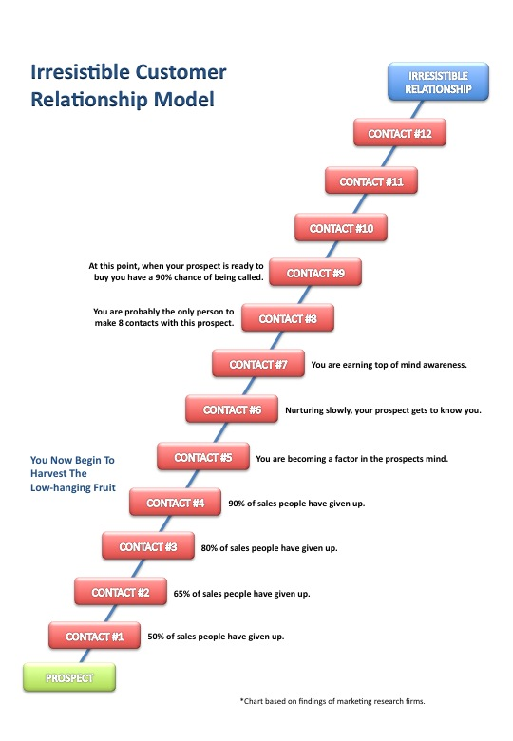
20. Follow Up
SECTION 3: GETTING RESULTS
MODULE 20
Using the ‘irresistible customer relationship model’ in all your marketing pays exponential dividends and means that you will make more than one approach and one attempt to sell.

Slide 59
20. Follow Up
Three Proven Follow Up Techniques:
  Send interesting articles.
  Email or mail tip sheets every 4-8 weeks.
  Send special reports.
Follow up techniques should be helpful to the prospect. They’re not sales orientated. They are all very ‘giving.’
ACTION
POINTS
SECTION 3: GETTING RESULTS
MODULE 20
How Often To Follow Up.
Follow up with information regularly and on the phone at comfortable intervals.
Don’t leave follow up longer than 6 weeks.
Use a Contact Management System to automate the system.

Slide 60
21. Selecting Additional Sales Conversion Strategies
Using A Raft Of Additional Proven Sales Conversion Strategies To Skyrocket Your Sales And Profits
ACTION
POINTS
Select more strategies to increase conversion further.
  Go to TALISMAN Volume 3 and go to Sales Conversion section.
  Choose your Sales Conversion Strategies.
  Prioritising Your Sales Conversion Strategies.
  Person Responsibility.
  Timing.
  Activate Your Sales Conversion System.
  Test.
SECTION 3: GETTING RESULTS
MODULE 21

Slide 61
22. Maximise The Income And Profit From New And Existing Clients Or Customers
Tapping Into The Most Lucrative Part Of Your Business
An effortless business growth area that all businesses can use to MASSIVELY increase their sales and profits.
“A simple follow up system that results in increasing the amount of money a client spends with you over the lifetime of the relationship, by increasing the average order value, increasing the frequency of purchase, getting more referrals from them, and keeping them as clients for longer.”
SECTION 3: GETTING RESULTS
MODULE 22
It costs at least 8 times more to get new clients or customers than it does to sell to existing ones.
Clients or customers are your single biggest asset. They already trust you. They already know how good you are. So why wouldn’t you keep selling back to them?

Slide 62
22. Maximise The Income And Profit From New And Existing Clients Or Customers
There are seven ways to grow a business:
  Increasing the number of clients or customers.
  Increasing your conversion rate.
  Increasing the average value of each order or purchase.
  Increasing the average frequency of purchase (i.e. the number of times a client or customer buys from you).
  Increasing customer retention. (i.e. the average number of years they remain your customer or client).
  Increasing the average number of referrals.
  Increasing profit margins.
It is extremely simple to ethically extract more and more money out of your clients or customers.
SECTION 3: GETTING RESULTS
MODULE 22

Slide 63
22. Maximise The Income And Profit From New And Existing Clients Or Customers
ACTION
POINTS
Select more strategies to increase business further.
  Go to TALISMAN Volume 3 and read through the following sections:
    Boosting The Size Of Customer Transactions
    Increasing The Frequency Of Purchase
    Increasing The Number Of Years Customers Do Business With You
    Getting More Referrals
  Choose your Strategies for each EACH section.
  Prioritising Your Strategies.
  Person Responsibility.
  Timing.
  Activate Your System.
  Test.
SECTION 3: GETTING RESULTS
MODULE 22

Slide 64
23. Improving Profit Margins
Strategies To Increase Bottom Line Profits.
ACTION
POINTS
Select more strategies to increase conversion further.
  Go to TALISMAN Volume 3 and go to Increasing Profits section.
  Choose your Strategies.
  Prioritising Your Strategies.
  Person Responsibility.
  Timing.
  Activate Your System.
  Test.
SECTION 3: GETTING RESULTS
MODULE 23

